Slide 1
Introduction to Data Analysis

Slide 2
BASIC DATA ANALYSIS
Patrick Boily Data Action Lab | uOttawa | Idlewyld Analytics
pboily@uottawa.ca
[with files from Jen Schellinck | Sysabee]

Slide 3
DATA ANALYSIS PIPELINE
Data modeling and conceptual analysis
Data collection
Data transformation
Data storage
Data exploration
Data analysis
Data presentation

Slide 4
INSIGHTS & # Crunching Core Concepts
BASIC DATA ANALYSIS

Slide 5
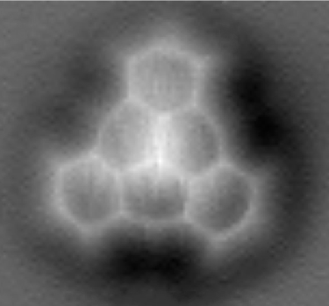
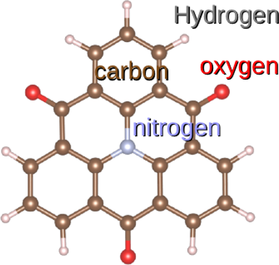
PATTERNS, GENERALIZATIONS, STRUCTURE
[https://upload.wikimedia.org/wikipedia/commons/d/d0/TOAT_AFM.png]
Pattern: a predictable, repeating regularity
Structure: an organization of elements in a system
Generalization: creation of more general or abstract concepts from more specific concepts or instances
Underlying goal during analysis: find patterns or structure in the data and draw conclusions via these patterns or structures.
Finding patterns and structure is not pointless, per se, but it is how these discoveries are used to draw insights that is important.

Slide 6
DEPENDENT VS. INDEPENDENT VARIABLES
In an experimental setting:
control/extraneous variables: we do our best to keep these controlled and unchanging while other variables are changed
independent variables: we control their values as we suspect they influence the dependent variables
dependent variables: we do not control their values; they are generated in some way during the experiment, and presumably are dependent on everything else
How do these translate over to other datasets?
Plant height
Sunlight hours

Slide 7
DATA TYPES
Numerical data: integers or continuous numbers
1, 7, 34.654, 0.000004
Text data: strings of text – may be restricted to a certain number of characters
“Welcome to the park”, “AAAAA”, “345”, “45.678”
Categorical data: a fixed number of values, may be numeric or represented by strings. There is no specific or inherent ordering
(‘red’,’blue’,’green’), (‘1’,’2’,’3’)
Ordinal data: categorical data with an inherent ordering. Unlike integer data, the spacing between values is not defined
(very cold, cold, tepid, warm, super hot)

Slide 8
CATEGORICAL → NUMERICAL
Categorical data can be turned into numerical data by generating frequency counts of the different values of the categorical variable.
This in turn allows us to apply numerical analysis techniques.
House colour | Frequency
red | 40
blue | 13
green | 2

Slide 9
SPECIAL ROLE OF CATEGORICAL DATA
Categorical data plays a special role:
in data science, categorical variables come with a pre-defined set of values
in experimental science, a factor is an independent variable with its levels being defined (it may also be viewed as a category of treatment)
in business analytics, these are dimensions (with members) vs. measures
However they are labeled, they can be used to subset or roll up/summarize the data.

Slide 10
HIERARCHICAL/NESTED/MULTILEVEL DATA/MODELS
Year | Quarter | Count_Q
2012 | 1 | 34
2012 | 2 | 12
2012 | 3 | 52
2012 | 4 | 0
2013 | 1 | 21
2013 | 2 | 9
2013 | 3 | 112
2103 | 4 | 8
When a categorical variable has multiple levels of abstraction, new categorical variables can be created from these levels.
The ‘new’ categorical variable has pre-defined relationships with the more detailed level.
We can often zoom in and out with time/space variables.
Granularity of the data: what is the ‘maximum zoom’?
Year | Count_Y
2012 | 98
2013 | 150

Slide 11
Insights & # Crunching Core Techniques
BASIC DATA ANALYSIS

Slide 12
DATA SUMMARIZING
Min: smallest value
Max: largest value
Median: “middle” value
Mode: most frequent value
Unique Values: list of unique values
etc.
Signal | Type
4.31 | Blue
5.34 | Orange
3.79 | Blue
5.19 | Blue
4.93 | Green
5.76 | Orange
3.25 | Orange
7.12 | Orange
2.85 | Blue

Slide 13
ROLLING-UP DATA
Signal | Type
4.31 | Blue
5.34 | Orange
3.79 | Blue
5.19 | Blue
4.93 | Green
5.76 | Orange
3.25 | Orange
7.12 | Orange
2.85 | Blue
We can perform operations over a set (or subset) of the data, typically over its columns.
Such an operation is akin to compressing or 'rolling-up' the many data values into a single representative value.
Examples: 'mean', 'sum’, 'count’, ‘variance’, etc.
We can apply the same roll-up function to many different columns, providing a mapping (list) of columns to values.
Count | Signal avg | Signal stdev | Type mode
9 | 4.73 | 1.33 | Blue/ Orange

Slide 14
CONTINGENCY/PIVOT TABLES
Contingency table: a table which examines the relationship between two categorical variables via their relative (cross-tabulation).
Pivot table: a table generated by applying operations (sum, count, mean, etc.) to variables, possibly based on another (categorical) variable. Contingency tables as special cases of pivot tables.
Type | Count | Signal avg | Signal stdev
Blue | 4 | 4.04 | 0.98
Green | 1 | 4.93 | N.A.
Orange | 4 | 5.37 | 1.60
 | Large | Medium | Small
Window | 1 | 32 | 31
Door | 14 | 11 | 0

Slide 15
ANALYSIS THROUGH VISUALIZATION
Analysis (broad definition):
identifying patterns or structure
adding meaning to these patterns or structure by interpreting them in the context of the system.
Option 1: use analytical methods to achieve this.
Option 2: visualize the data and use the brain’s analytic power (perceptual) to reach meaningful conclusions about these patterns.
We will discuss further.

Slide 16
DATA DESCRIPTIONS (IN-DEPTH)
BASIC DATA ANALYSIS

Slide 17
DATA DESCRIPTIONS (REPRISE)
In a sense, the underlying reason for any analysis is to reach data understanding.
Studies and experiments give rise to units, which are typically described with variables (and measurements).
Variables are either qualitative (categorical) or quantitative (numerical):
categorical variables take values (levels) from a finite set of classes
numerical variables take values from a (potentially infinite) set of quantities

Slide 18
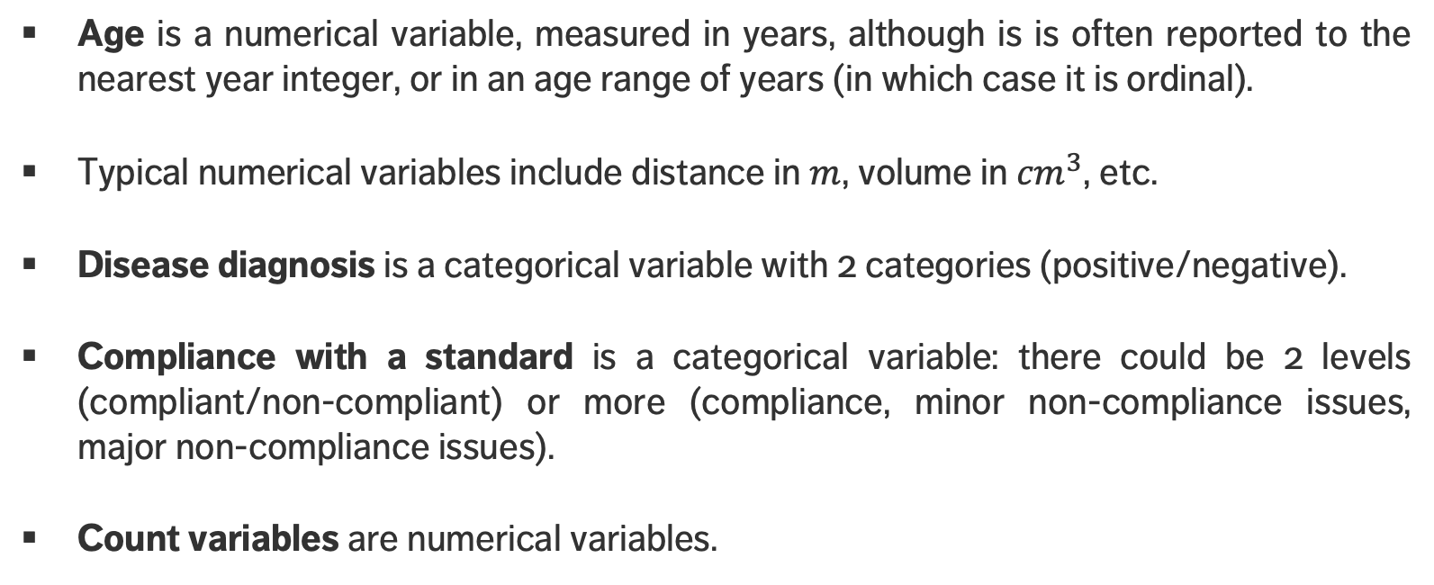
EXAMPLES
Age is a numerical variable, measured in years, although is is often reported to the nearest year integer, or in an age range of years (in which case it is ordinal).
Typical numerical variables include distance in $m$, volume in ${cm}^{3}$, etc.
Disease diagnosis is a categorical variable with 2 categories (positive/negative).
Compliance with a standard is a categorical variable: there could be 2 levels (compliant/non-compliant) or more (compliance, minor non-compliance issues, major non-compliance issues).
Count variables are numerical variables.

Slide 19
NUMERICAL SUMMARIES
In a first pass, a variable can be described along 2 dimensions: centrality & spread (skew and kurtosis are also used sometimes).
Centrality measures include:
median, mean, mode (less frequently)
Spread (or dispersion) measures include:
standard deviation (sd), variance, quartiles, inter-quartile range (IQR), range (less frequently).
The median, range and the quartiles are easily calculated from an ordered list of data.

Slide 20
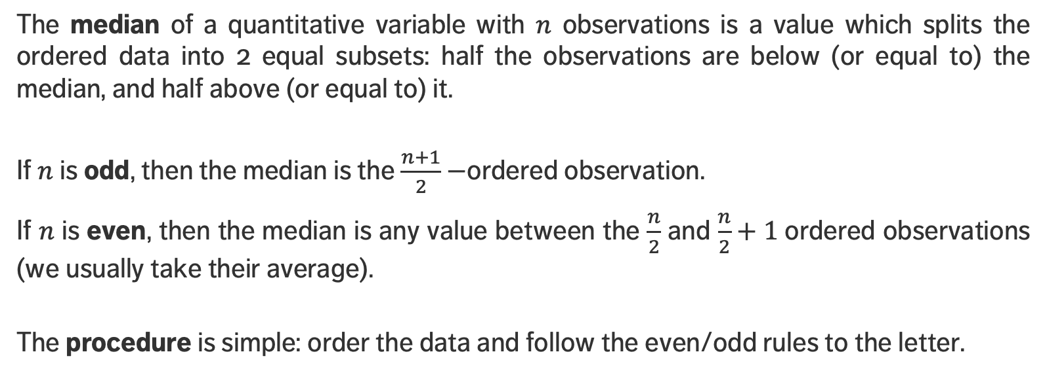
MEDIAN
The median of a quantitative variable with $n$ observations is a value which splits the ordered data into 2 equal subsets: half the observations are below (or equal to) the median, and half above (or equal to) it.
If $n$ is odd, then the median is the $\frac{n+1}{2}−$ordered observation.
If $n$ is even, then the median is any value between the $\frac{n}{2}$ and $\frac{n}{2}+1$ordered observations (we usually take their average).
The procedure is simple: order the data and follow the even/odd rules to the letter.

Slide 21
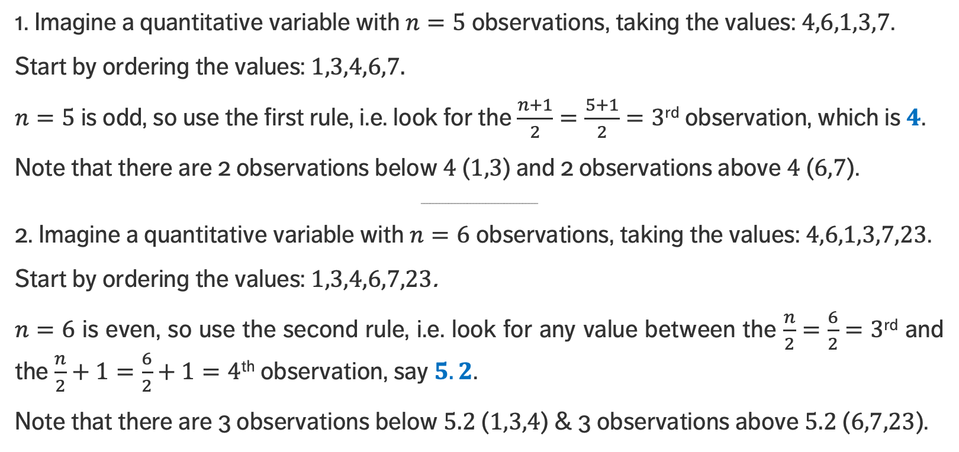
MEDIAN
1. Imagine a quantitative variable with $n=5$ observations, taking the values: $4,6,1,3,7$.
Start by ordering the values: $1,3,4,6,7.$
$n=5$ is odd, so use the first rule, i.e. look for the $\frac{n+1}{2}=\frac{5+1}{2}=3$^{rd} observation, which is $4$.
Note that there are 2 observations below $4$ ($1,3$) and 2 observations above $4$ ($6,7$).
______________________________________
2. Imagine a quantitative variable with $n=6$ observations, taking the values: $4,6,1,3,7,23$.
Start by ordering the values: $1,3,4,6,7,23$.
$n=6$ is even, so use the second rule, i.e. look for any value between the $\frac{n}{2}=\frac{6}{2}=3$^{rd} and the $\frac{n}{2}+1=\frac{6}{2}+1=4$^{th} observation, say $5.2$.
Note that there are 3 observations below $5.2$ ($1,3,4$) & 3 observations above $5.2$ ($6,7,23$).

Slide 22
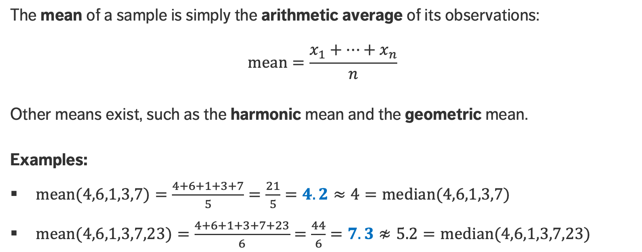
MEAN
The mean of a sample is simply the arithmetic average of its observations:
$$\text{mean}=\frac{x_{1}+…+x_{n}}{n}$$
Other means exist, such as the harmonic mean and the geometric mean.
Examples:
$m\text{ean}\text{(4,6,1,3,7)}=\frac{4+6+1+3+7}{5}=\frac{21}{5}=4.2≈4=m\text{e}\text{dian}\text{(4,6,1,3,7)}$
$m\text{ean}\text{(4,6,1,3,7,23)}=\frac{4+6+1+3+7+23}{6}=\frac{44}{6}=7.3≉5.2=m\text{edian}\text{(4,6,1,3,7,23)}$

Slide 23
MEAN OR MEDIAN?
Which measure of centrality should be used to report on the data?
The mean is theoretically supported (CLT, which won’t be discussed here).
If the data distribution is roughly symmetric then both values will be near one another.
If the data distribution is skewed, then the mean is pulled toward the long tail and as a result gives a distorted view of the true centre.
Consequently, medians are generally used for house prices, incomes etc.
The median is robust against outliers and incorrect readings whereas the mean is not.

Slide 24
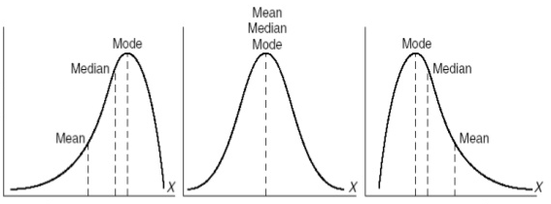
MEAN OR MEDIAN?
mean
median
mode
mode
mode
median
median
mean
mean

Slide 25
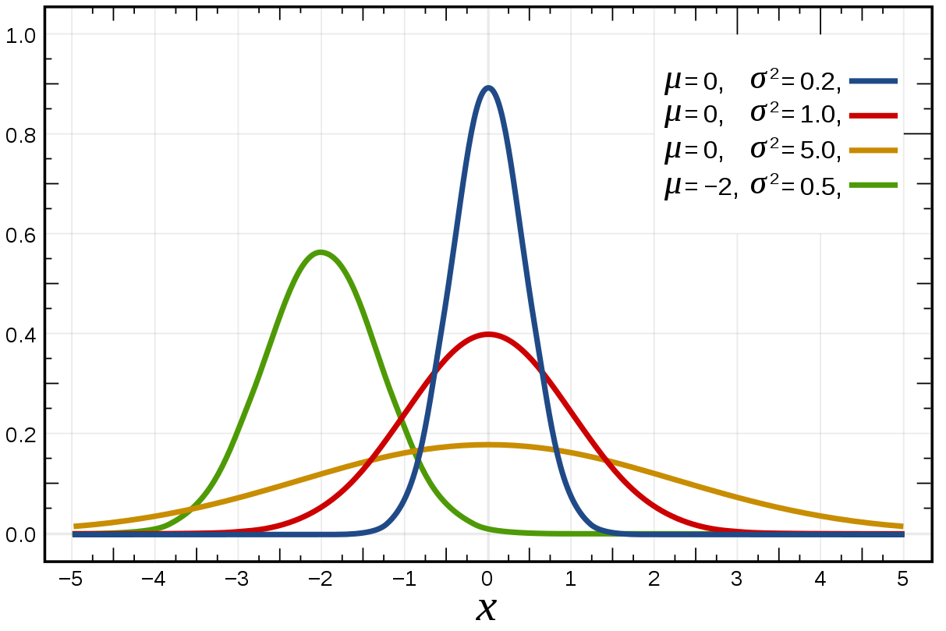
STANDARD DEVIATION
[Wikipedia]
The centrality measures provide an idea as to where the variable’s values are “massed”.
The standard deviation (sd) provides a notion of its spread; higher sd means higher spread.

Slide 26
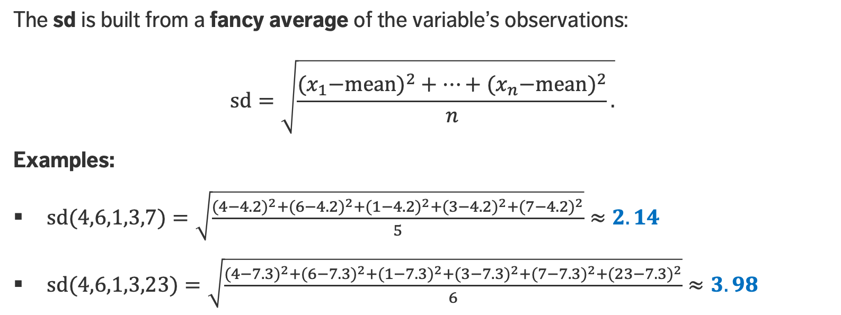
STANDARD DEVIATION
The sd is built from a fancy average of the variable’s observations:
$$\text{sd}=\sqrt{\frac{{{(x}_{1}−\text{mean})}^{2}+…+{{(x}_{n}−\text{mean})}^{2}}{n}.}$$
Examples:
$sd\text{(4,6,1,3,7)}=\sqrt{\frac{{(4−4.2)}^{2}+{(6−4.2)}^{2}+{(1−4.2)}^{2}+{(3−4.2)}^{2}+{(7−4.2)}^{2}}{5}}≈2.14$
$sd\text{(4,6,1,3,}\text{23}\text{)}=\sqrt{\frac{{(4−7.3)}^{2}+{(6−7.3)}^{2}+{(1−7.3)}^{2}+{(3−7.3)}^{2}+{(7−7.3)}^{2}+{(23−7.3)}^{2}}{6}}≈3.98$

Slide 27
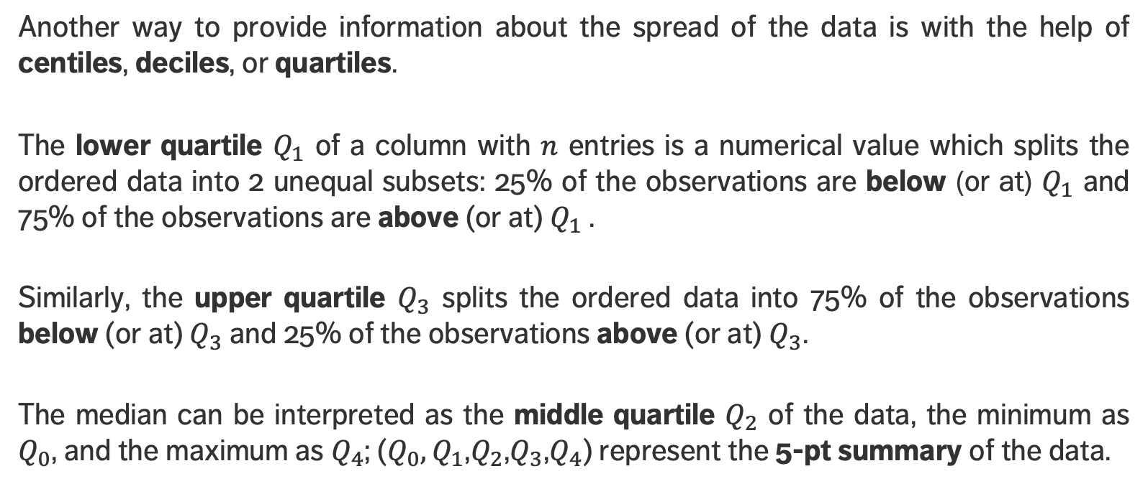
QUANTILES
Another way to provide information about the spread of the data is with the help of centiles, deciles, or quartiles.
The lower quartile $Q_{1}$ of a column with $n$ entries is a numerical value which splits the ordered data into 2 unequal subsets: 25% of the observations are below (or at) $Q_{1}$ and 75% of the observations are above (or at) $Q_{1}$ .
Similarly, the upper quartile $Q_{3}$ splits the ordered data into 75% of the observations below (or at) $Q_{3}$ and 25% of the observations above (or at) $Q_{3}$.
The median can be interpreted as the middle quartile $Q_{2}$ of the data, the minimum as $Q_{0}$, and the maximum as $Q_{4}$; ($Q_{0},Q_{1}$,$Q_{2}$,$Q_{3}$,$Q_{4}$) represent the 5-pt summary of the data.

Slide 28
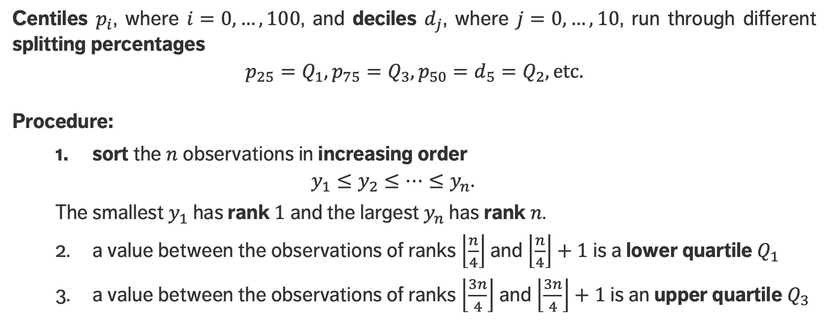
QUANTILES
Centiles $p_{i}$, where $i=0,…,100$, and deciles $d_{j}$, where $j=0,…,10$, run through different splitting percentages
$$p_{25}=Q_{1},p_{75}=Q_{3},p_{50}=d_{5}=Q_{2}, \text{etc}.$$
Procedure:
sort the $n$ observations in increasing order
$$y_{1}≤y_{2}≤…≤y_{n}.$$
The smallest $y_{1}$ has rank $1$ and the largest $y_{n}$ has rank $n$.
a value between the observations of ranks $\left\lfloor \frac{n}{4}\right\rfloor$ and $\left\lfloor \frac{n}{4}\right\rfloor +1$ is a lower quartile $Q_{1}$
a value between the observations of ranks $\left\lfloor \frac{3n}{4}\right\rfloor$ and $\left\lfloor \frac{3n}{4}\right\rfloor +1$ is an upper quartile $Q_{3}$

Slide 29
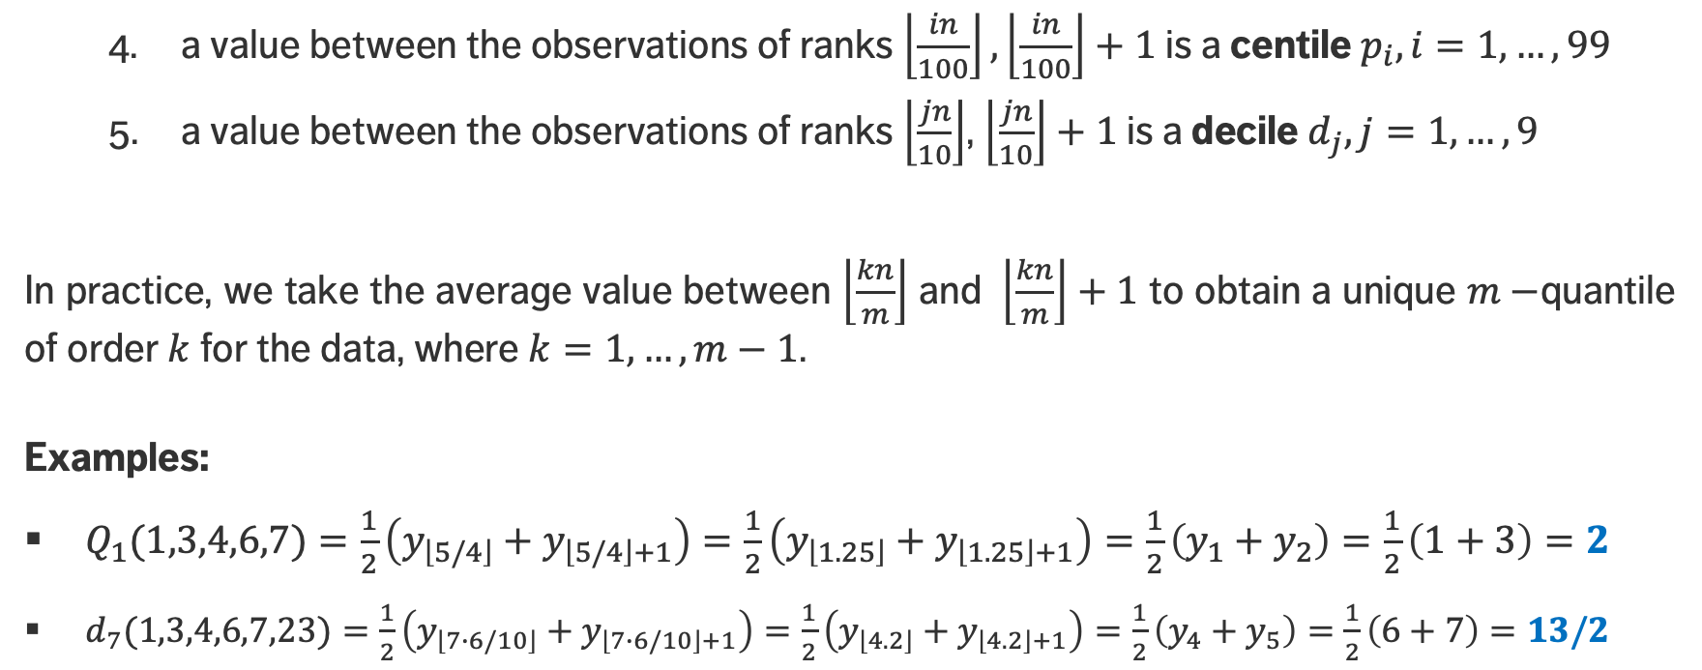
QUANTILES
a value between the observations of ranks $\left\lfloor \frac{in}{100}\right\rfloor ,\left\lfloor \frac{in}{100}\right\rfloor +1$ is a centile $p_{i}, i=1,…, 99$
a value between the observations of ranks $\left\lfloor \frac{jn}{10}\right\rfloor$, $\left\lfloor \frac{jn}{10}\right\rfloor +1$ is a decile $d_{j}, j=1,…, 9$
In practice, we take the average value between $\left\lfloor \frac{kn}{m}\right\rfloor$ and $\left\lfloor \frac{kn}{m}\right\rfloor +1$ to obtain a unique $m−$quantile of order $k$ for the data, where $k=1,…, m−1$.
Examples:
$Q_{1}\text{(}\text{1,3,4,6,7}\text{)}=\frac{1}{2}\left(y_{\left\lfloor 5/4\right\rfloor }+y_{\left\lfloor 5/4\right\rfloor +1}\right)=\frac{1}{2}\left(y_{\left\lfloor 1.25\right\rfloor }+y_{\left\lfloor 1.25\right\rfloor +1}\right)=\frac{1}{2}\left(y_{1}+y_{2}\right)=\frac{1}{2}\left(1+3\right)=2$
$d_{7}\text{(}\text{1,3,4,6,7,23}\text{)}=\frac{1}{2}\left(y_{\left\lfloor 7∙6/10\right\rfloor }+y_{\left\lfloor 7∙6/10\right\rfloor +1}\right)=\frac{1}{2}\left(y_{\left\lfloor 4.2\right\rfloor }+y_{\left\lfloor 4.2\right\rfloor +1}\right)=\frac{1}{2}\left(y_{4}+y_{5}\right)=\frac{1}{2}\left(6+7\right)=13/2$

Slide 30
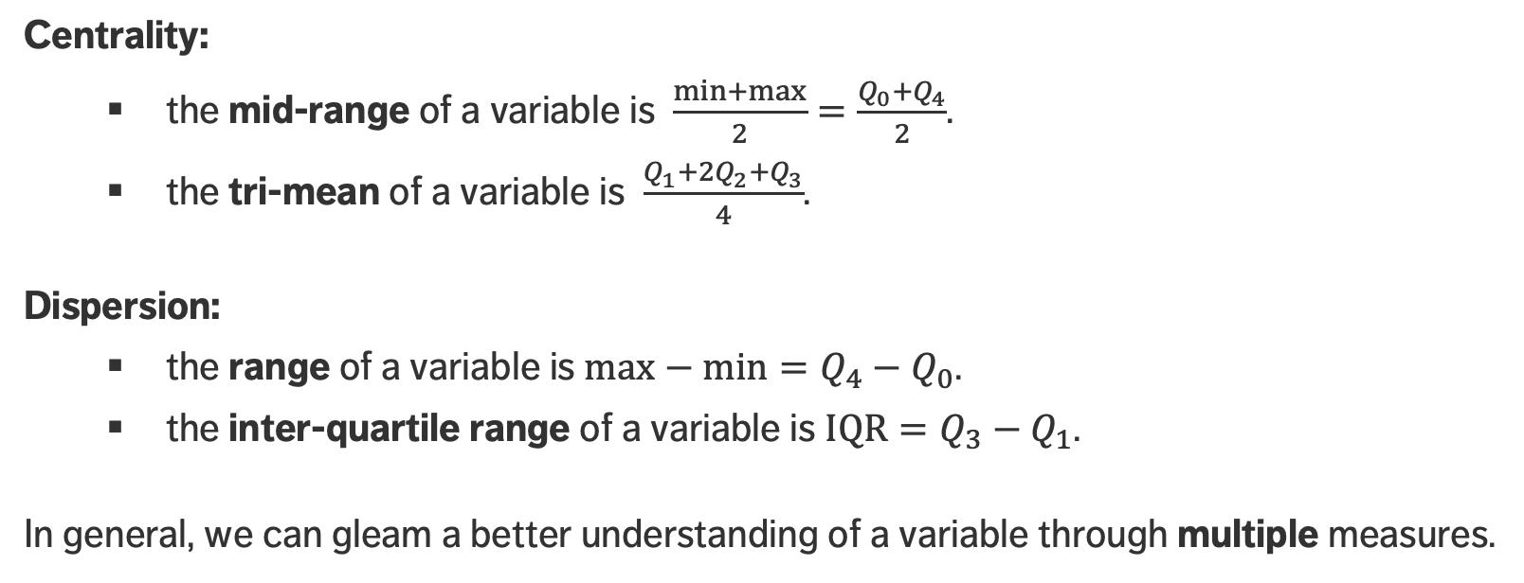
OTHER MEASURES
Centrality:
the mid-range of a variable is $\frac{min+max}{2}=\frac{Q_{0}+Q_{4}}{2}$.
the tri-mean of a variable is $\frac{Q_{1}+2Q_{2}+Q_{3}}{4}$.
Dispersion:
the range of a variable is $max−min=Q_{4}−Q_{0}$.
the inter-quartile range of a variable is $\text{IQR}=Q_{3}−Q_{1}$.
In general, we can gleam a better understanding of a variable through multiple measures.

Slide 31
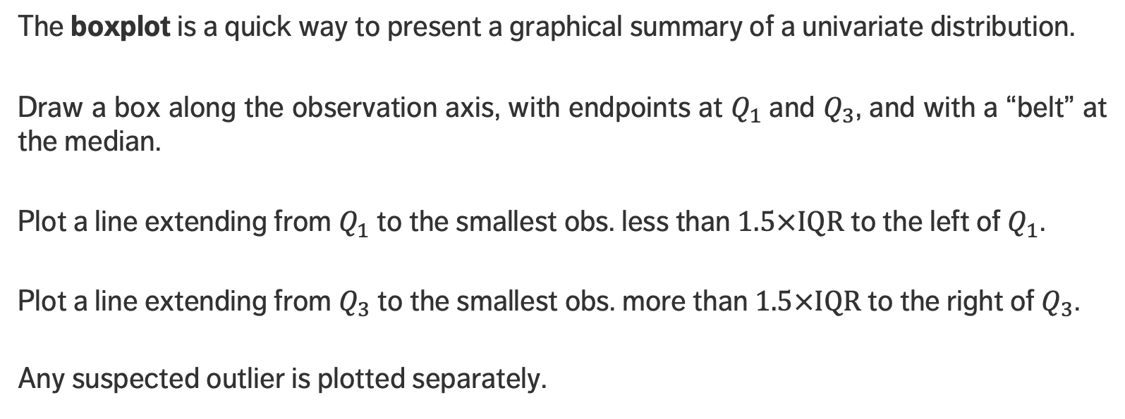
VISUAL SUMMARIES – BOXPLOT
The boxplot is a quick way to present a graphical summary of a univariate distribution.
Draw a box along the observation axis, with endpoints at $Q_{1}$and $Q_{3}$, and with a “belt” at the median.
Plot a line extending from $Q_{1}$ to the smallest obs. less than $1.5×IQR$ to the left of $Q_{1}$.
Plot a line extending from $Q_{3}$ to the smallest obs. more than $1.5×IQR$ to the right of $Q_{3}$.
Any suspected outlier is plotted separately.

Slide 32
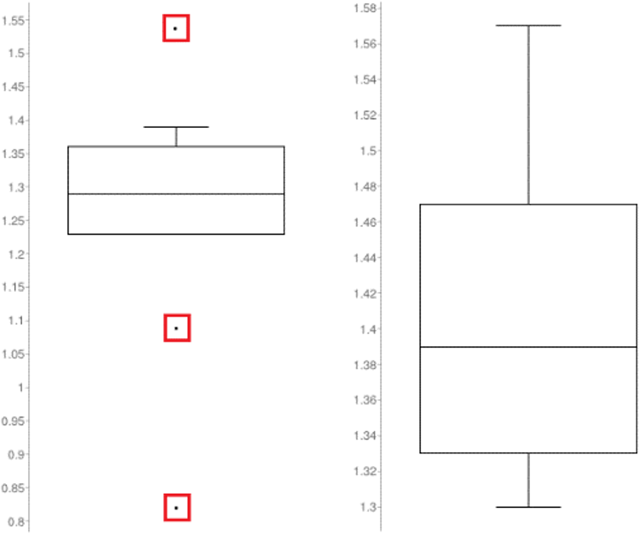
EXAMPLES
Queuing dataset: arrival rates (left), processing rates (right)

Slide 33
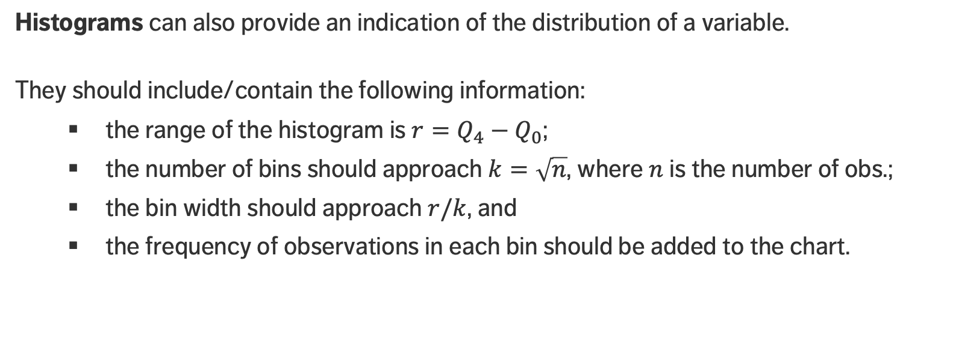
VISUAL SUMMARIES – HISTOGRAM
Histograms can also provide an indication of the distribution of a variable.
They should include/contain the following information:
the range of the histogram is $r=Q_{4}−Q_{0}$;
the number of bins should approach $k=\sqrt{n}$, where $n$ is the number of obs.;
the bin width should approach $r/k$, and
the frequency of observations in each bin should be added to the chart.

Slide 34
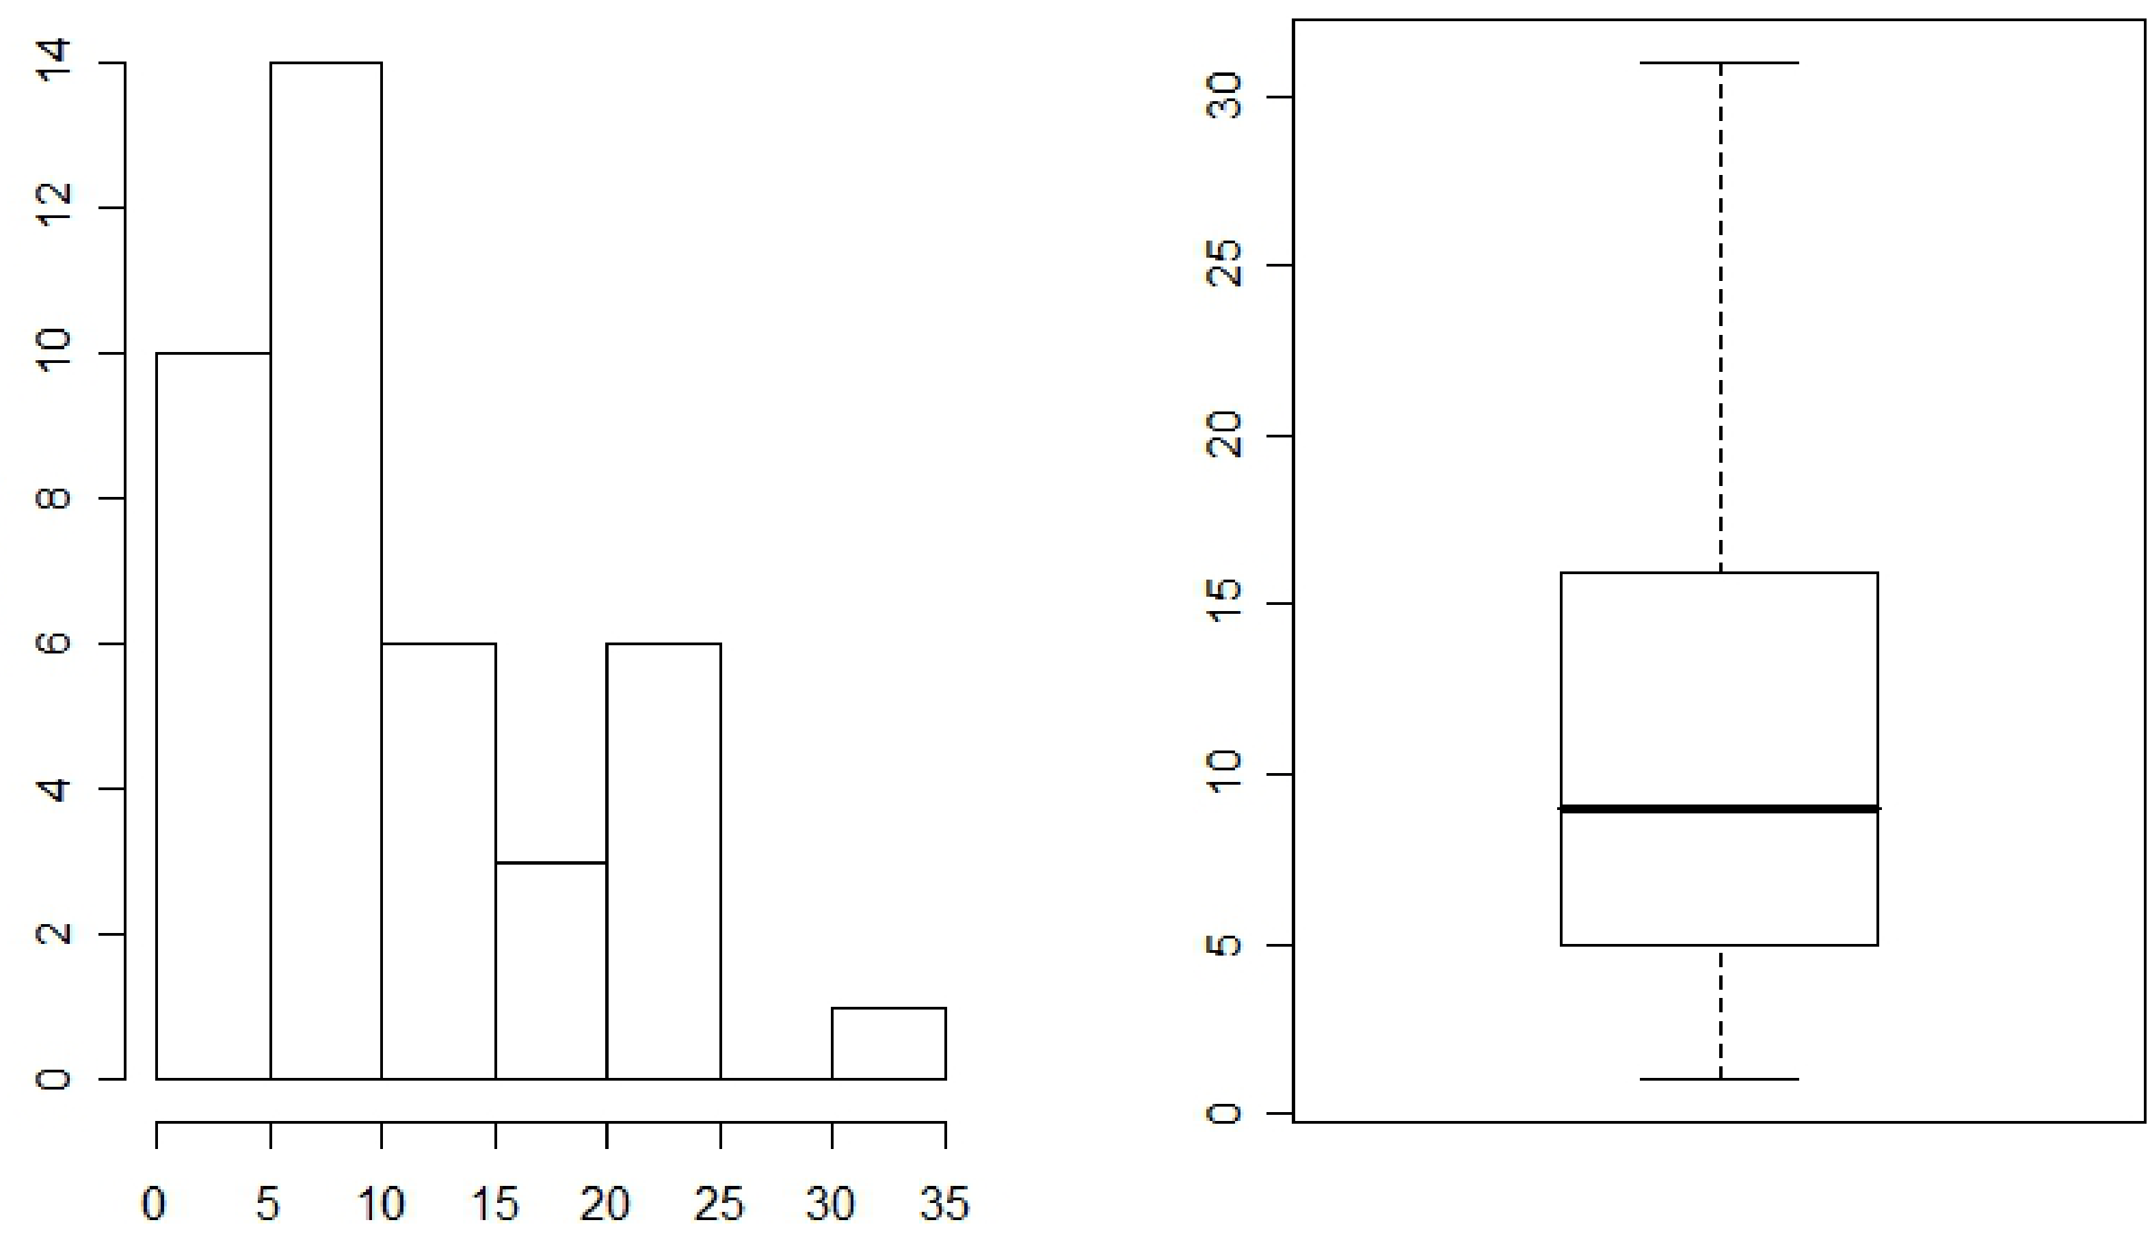
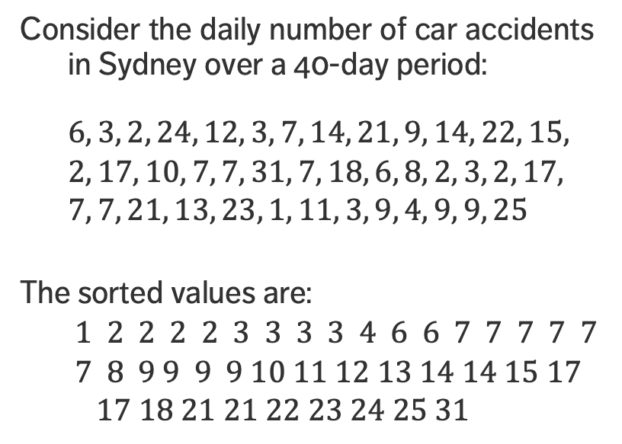
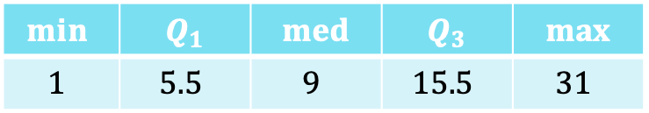
EXAMPLE
Is it more likely that one would see between 5-15 accidents on a given day, or between 25-35?
Consider the daily number of car accidents in Sydney over a 40-day period:
$$6, 3, 2, 24, 12, 3, 7, 14, 21, 9, 14, 22, 15,$$
$$2, 17, 10, 7, 7, 31, 7, 18, 6, 8, 2, 3, 2, 17,$$
$$7, 7, 21, 13, 23, 1, 11, 3, 9, 4, 9, 9, 25$$
The sorted values are:
$$1 2 2 2 2 3 3 3 3 4 6 6 7 7 7 7 7$$
$$7 8 9 9 9 9 10 11 12 13 14 14 15 17$$
$$17 18 21 21 22 23 24 25 31$$
$$min⁡$$ | $$Q_{1}$$ | $$med$$ | $$Q_{3}$$ | $$max$$
$$1$$ | $$5.5$$ | $$9$$ | $$15.5$$ | $$31$$

Slide 35
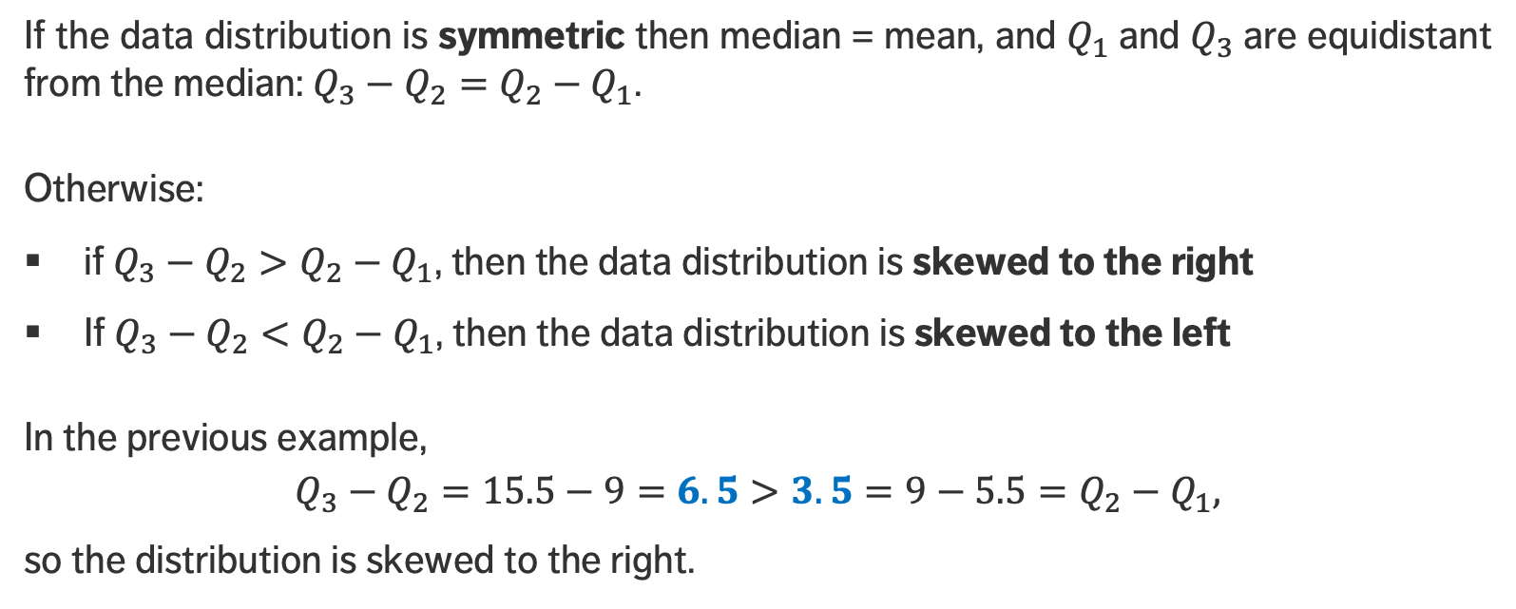
SKEWNESS
If the data distribution is symmetric then median = mean, and $Q_{1}$and $Q_{3}$are equidistant from the median: $Q_{3}−Q_{2}=Q_{2}−Q_{1}$.
Otherwise:
if $Q_{3}−Q_{2}>Q_{2}−Q_{1}$, then the data distribution is skewed to the right
If $Q_{3}−Q_{2}<Q_{2}−Q_{1}$, then the data distribution is skewed to the left
In the previous example,
$$Q_{3}−Q_{2}=15.5−9=6.5>3.5=9−5.5=Q_{2}−Q_{1},$$
so the distribution is skewed to the right.

Slide 36
SKEWNESS
skewed to the left
symmetric
skewed to the right
The shape of a dataset can be used to suggest an analytical model for the situation of interest.

Slide 37
CORRELATION
BASIC DATA ANALYSIS

Slide 38
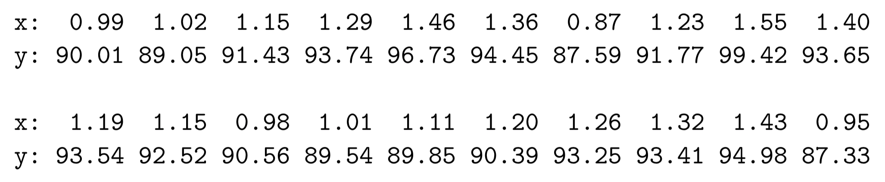
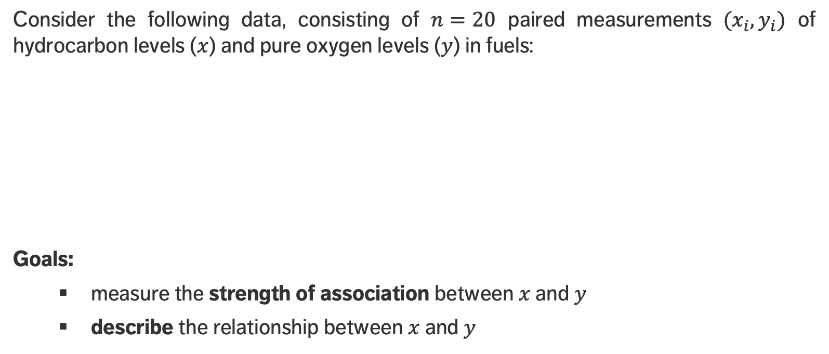
MOTIVATING EXAMPLE
Consider the following data, consisting of $n=20$ paired measurements $(x_{i},y_{i})$ of hydrocarbon levels ($x$) and pure oxygen levels ($y$) in fuels:
Goals:
measure the strength of association between $x$and $y$
describe the relationship between $x$and $y$

Slide 39
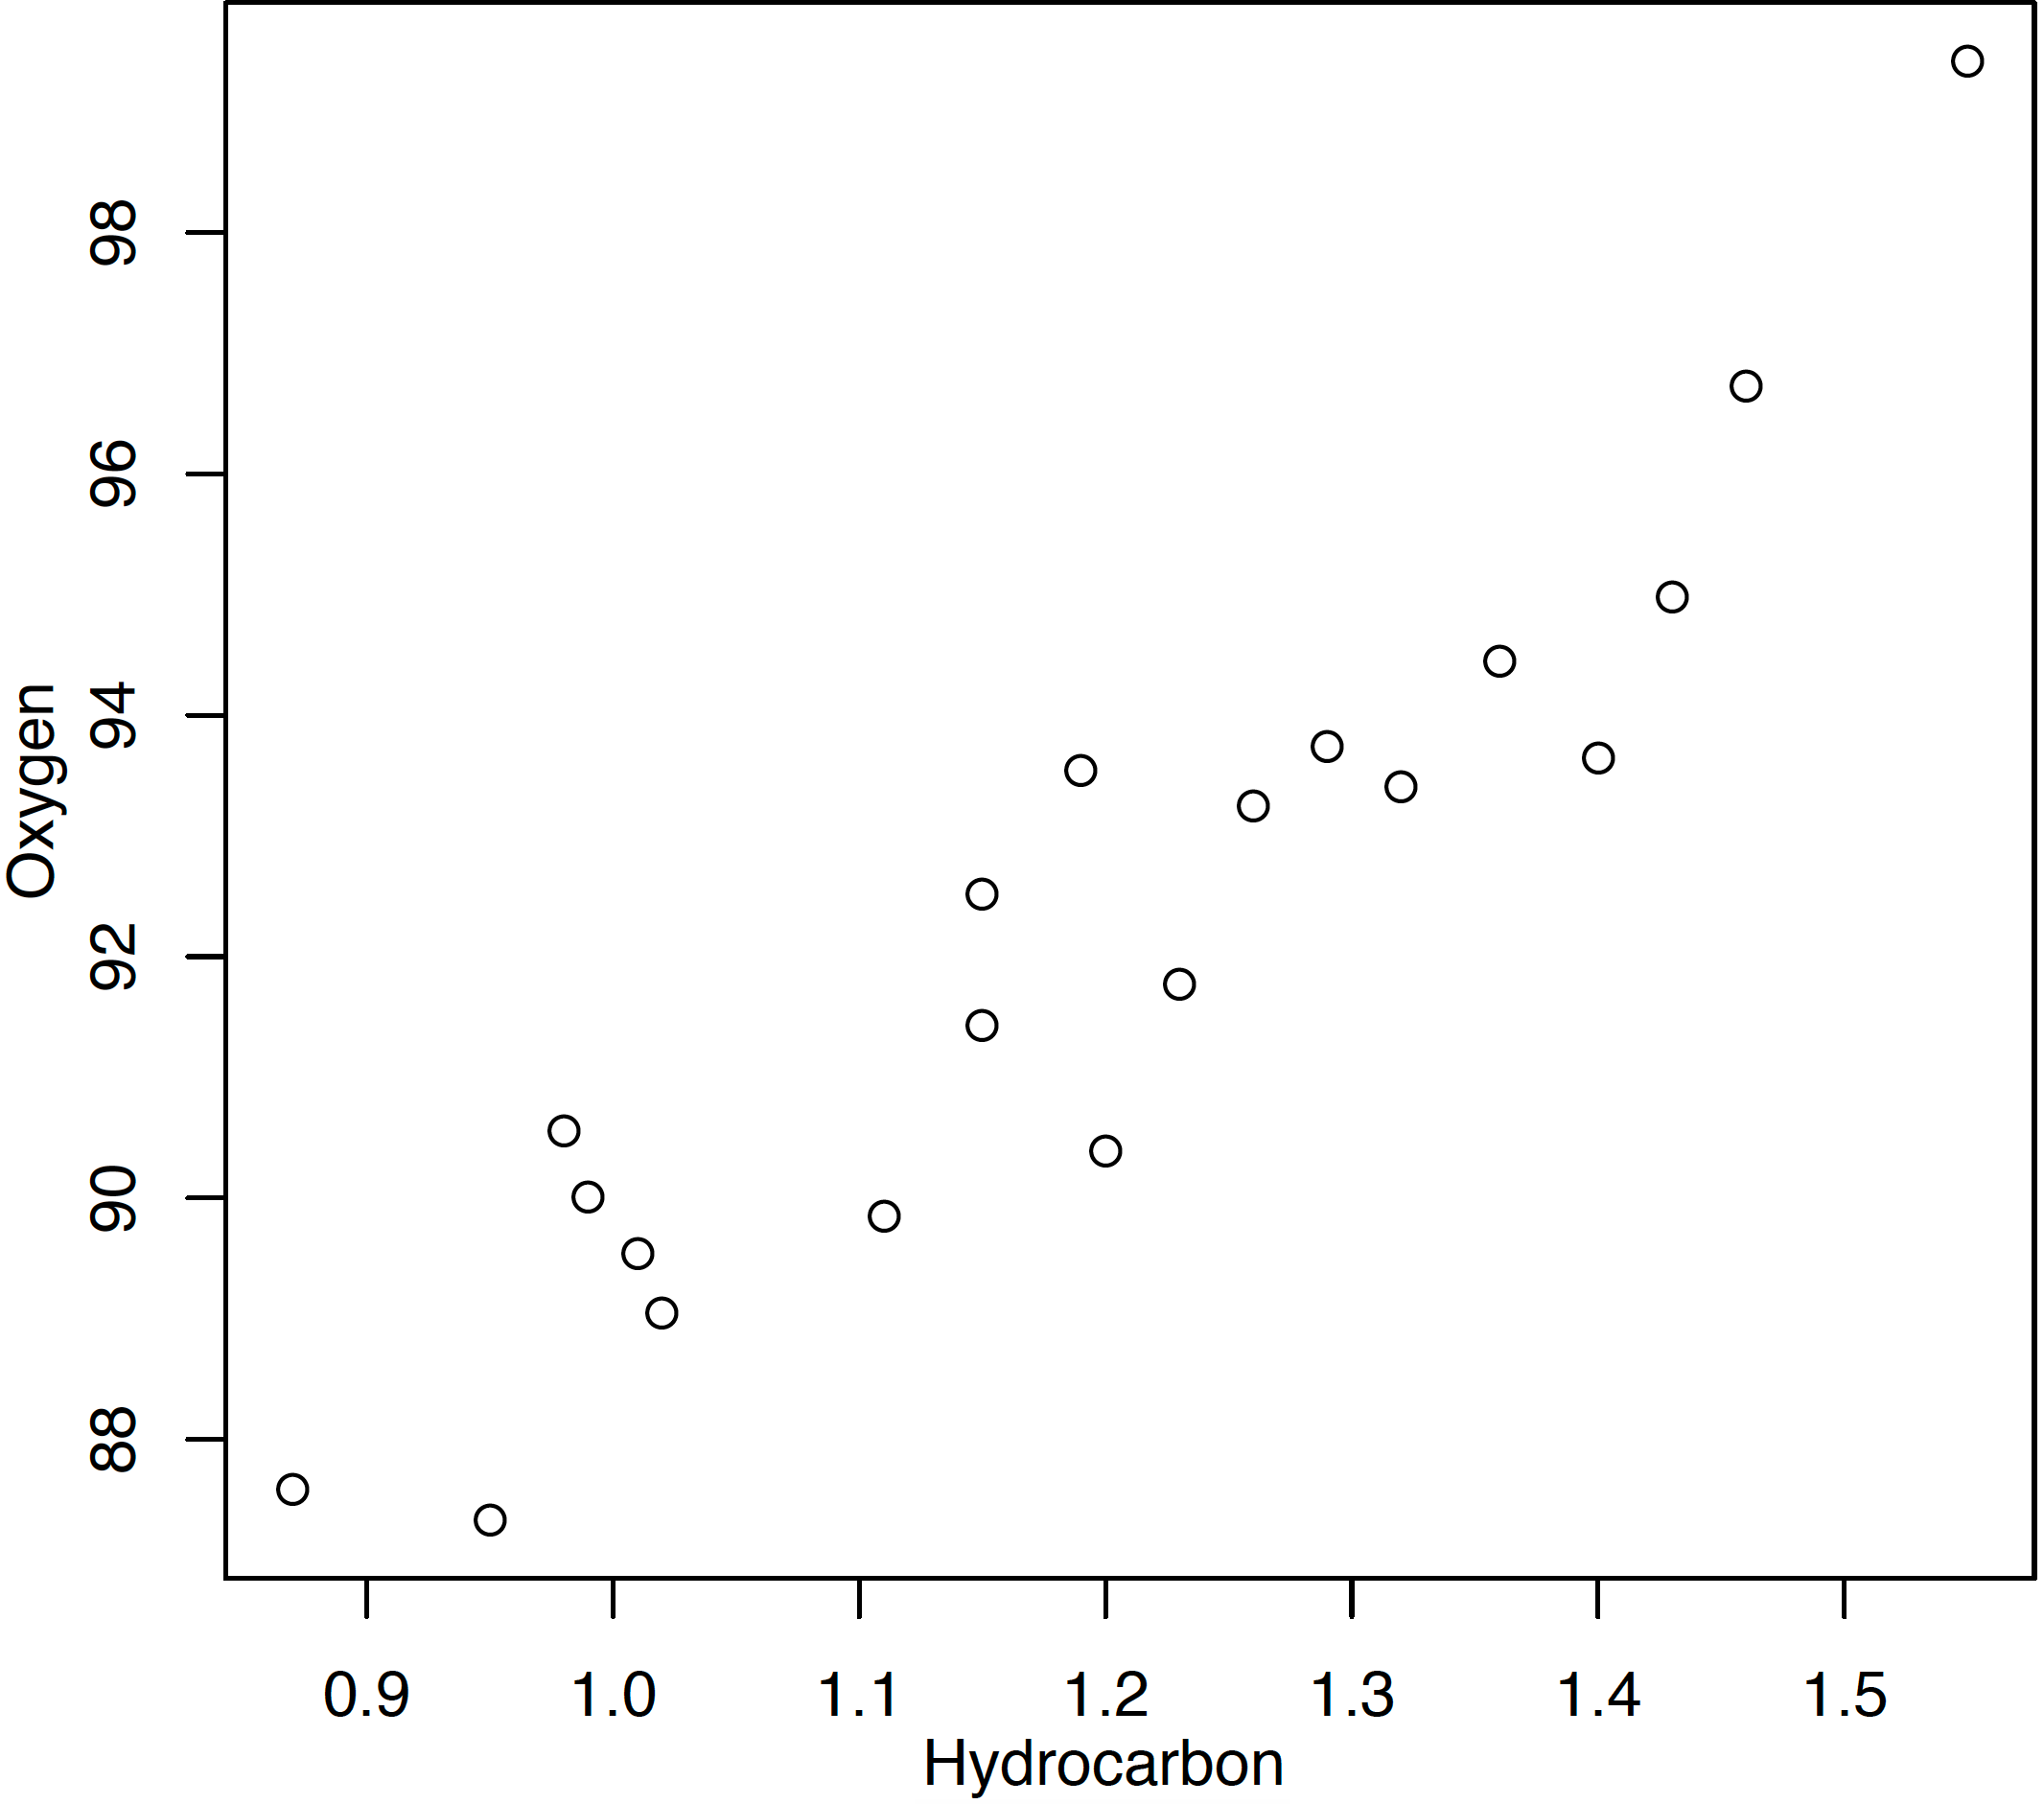
MOTIVATING EXAMPLE
A graphical display provides an initial description of the relationship.
It seems that points lie around a hidden line!
oxygen
hydrocarbon

Slide 40
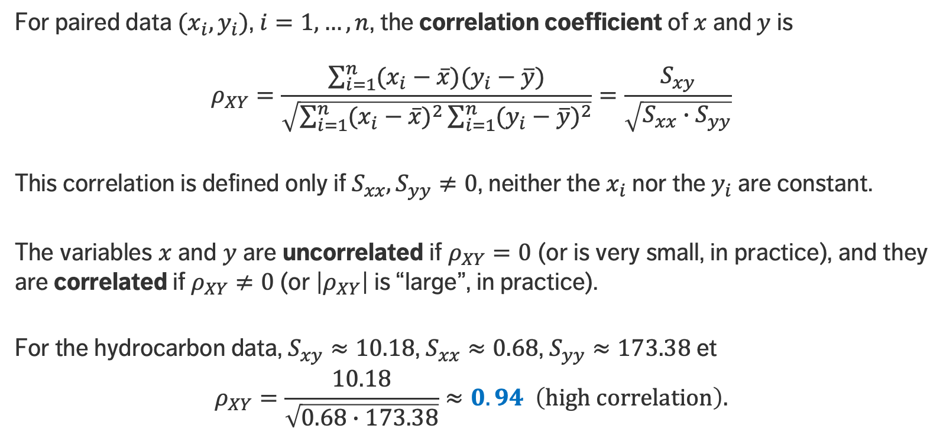
COEFFICIENT OF CORRELATION
For paired data $(x_{i},y_{i})$, $i=1,…,n$, the correlation coefficient of $x$and $y$ is
$$ρ_{XY}=\frac{\sum_{i=1}^{n}{(x_{i}−\overline{x})(y_{i}−\overline{y})}}{\sqrt{\sum_{i=1}^{n}{{(x_{i}−\overline{x})}^{2}}\sum_{i=1}^{n}{{(y_{i}−\overline{y})}^{2}}}}=\frac{S_{xy}}{\sqrt{S_{xx}∙S_{yy}}}$$
This correlation is defined only if $S_{xx},S_{yy}≠0$, neither the $x_{i}$ nor the $y_{i}$are constant.
The variables $x$ and $y$ are uncorrelated if $ρ_{XY}=0$ (or is very small, in practice), and they are correlated if $ρ_{XY}≠0$ (or $\left|ρ_{XY}\right|$is “large”, in practice).
For the hydrocarbon data, $S_{xy}≈10.18$, $S_{xx}≈0.68$, $S_{yy}≈173.38$et
$$ρ_{XY}=\frac{10.18}{\sqrt{0.68∙173.38}}≈0.94 \left(\text{high} \text{correlation}\right).$$

Slide 41
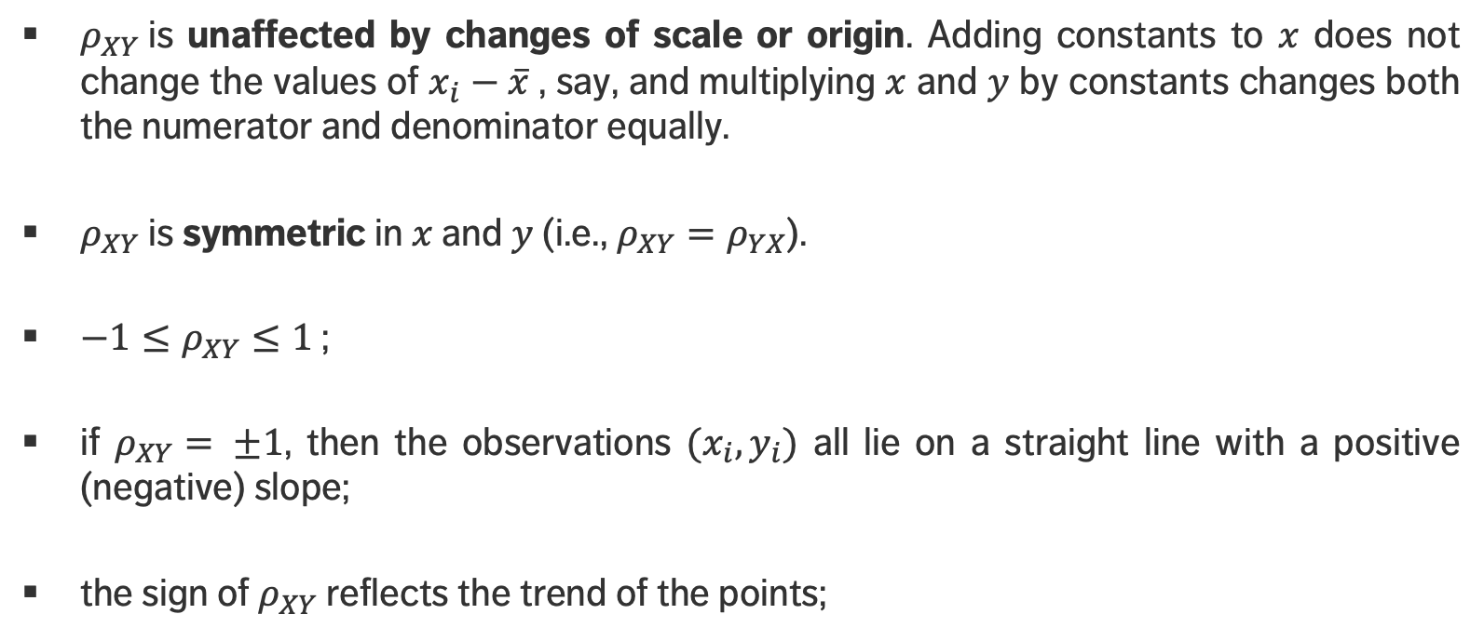
PROPERTIES AND INTERPRETATION
$ρ_{XY}$is unaffected by changes of scale or origin. Adding constants to $x$ does not change the values of $x_{i}−\overline{x}$, say, and multiplying $x$ and $y$ by constants changes both the numerator and denominator equally.
$ρ_{XY}$is symmetric in $x$ and $y$ (i.e., $ρ_{XY}=ρ_{YX}$).
$−1≤ρ_{XY}≤1$;
if $ρ_{XY}= ±1$, then the observations $(x_{i},y_{i})$ all lie on a straight line with a positive (negative) slope;
the sign of $ρ_{XY}$reflects the trend of the points;

Slide 42
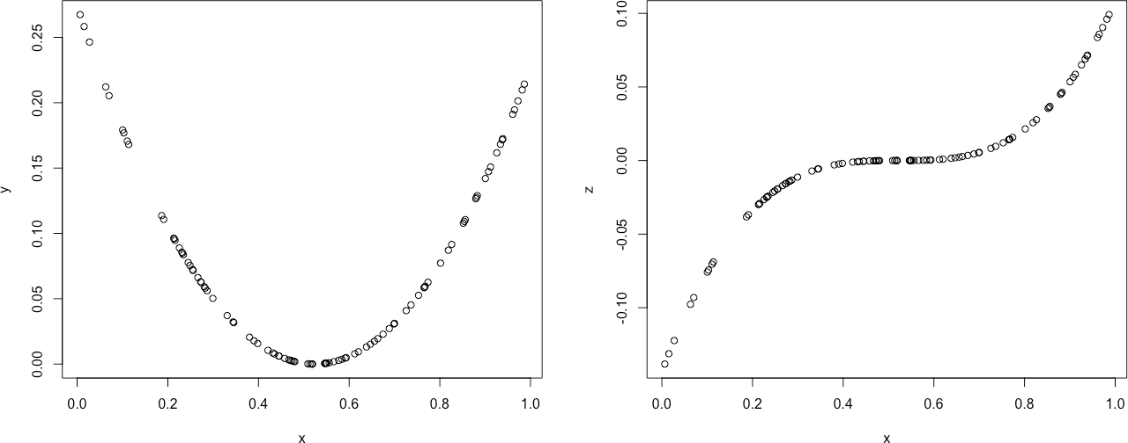
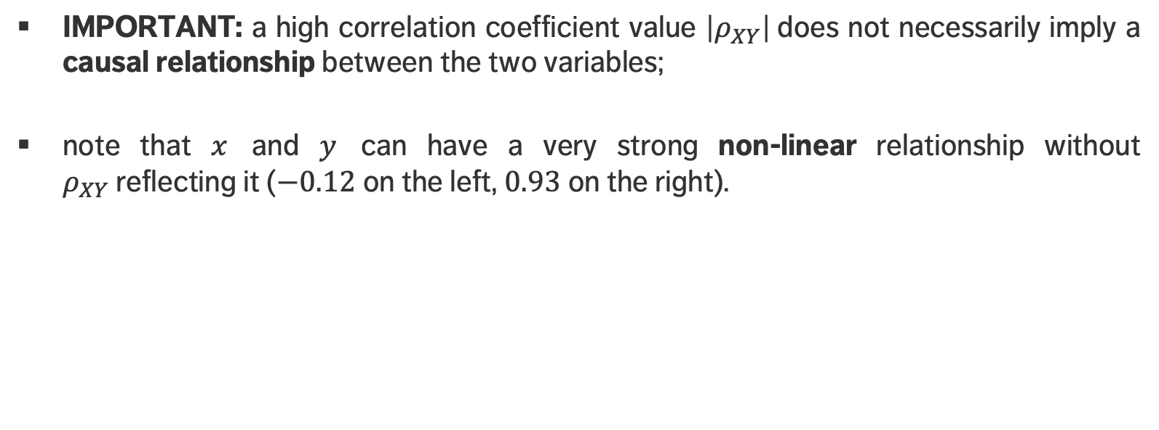
PROPERTIES AND INTERPRETATION
IMPORTANT: a high correlation coefficient value $\left|ρ_{XY}\right|$does not necessarily imply a causal relationship between the two variables;
note that $x$ and $y$ can have a very strong non-linear relationship without $ρ_{XY}$reflecting it ($−0.12$ on the left, $0.93$ on the right).

Slide 43
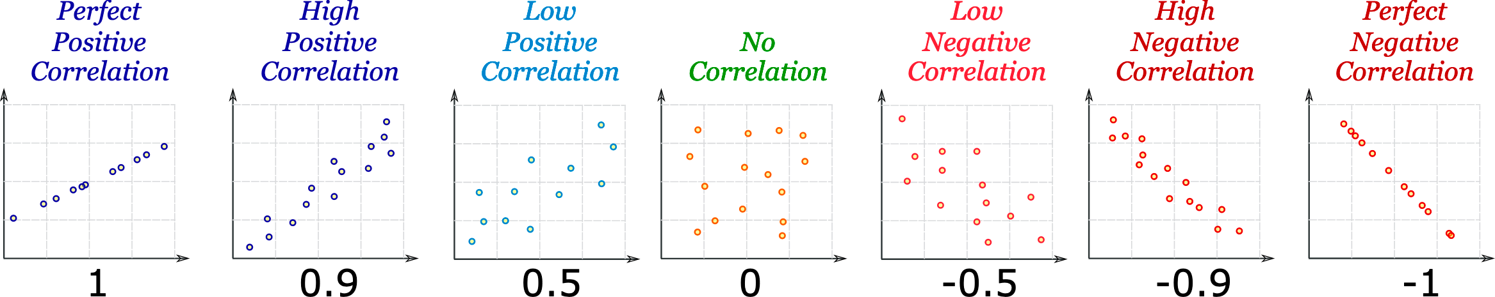
PROPERTIES AND INTERPRETATION
[Unknown author]
perfect positive correlation
high positive correlation
low
positive correlation
no correlation
low negative
correlation
high negative correlation
perfect
negative correlation

Slide 44
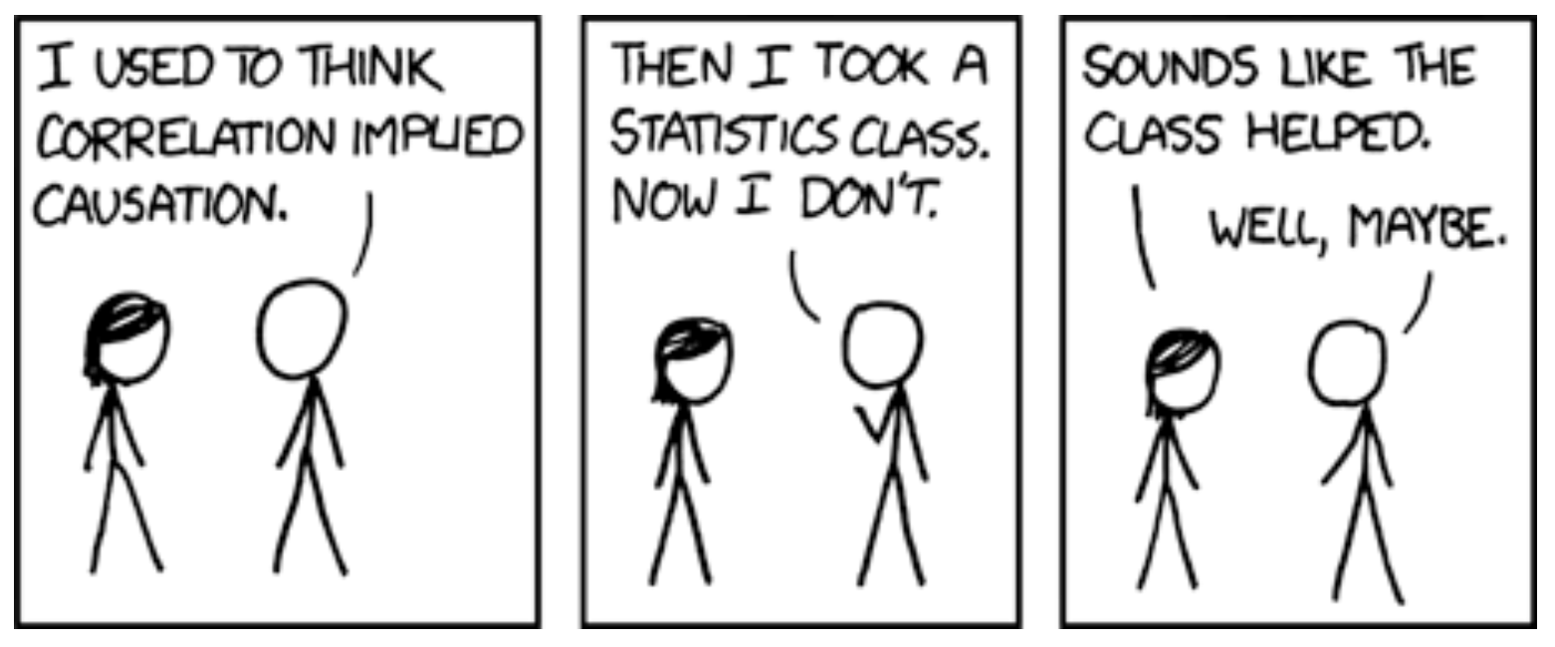
[https://xkcd.com/552/]
Correlation doesn't imply causation, but it does waggle its eyebrows suggestively and gesture furtively while mouthing 'look over there'.

Slide 45
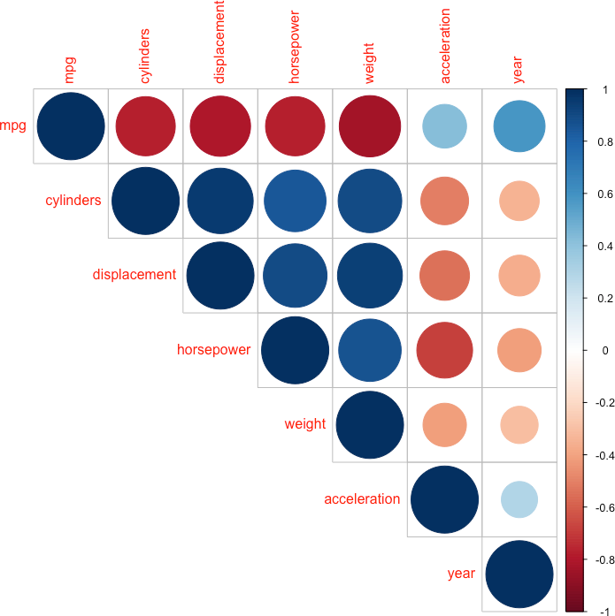

Slide 46
REGRESSION ANALYSIS
BASIC DATA ANALYSIS

Slide 47
REGRESSION MODELING
The most common data modeling methods are regressions, both linear and logistic.
About 80% of real data applications end up using a simple regression as their final model, typically after very careful data preparation, encoding, and creation of variables.
There are several reasons for their frequent use:
generally straightforward to understand and to train
mean square error (MSE) objective function has a closed-form linear solution
system of equations can usually be solved through matrix inversion or linear manipulation

Slide 48
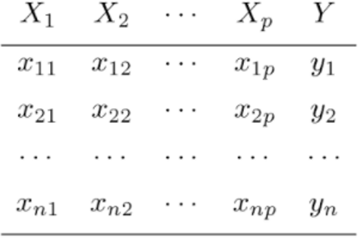
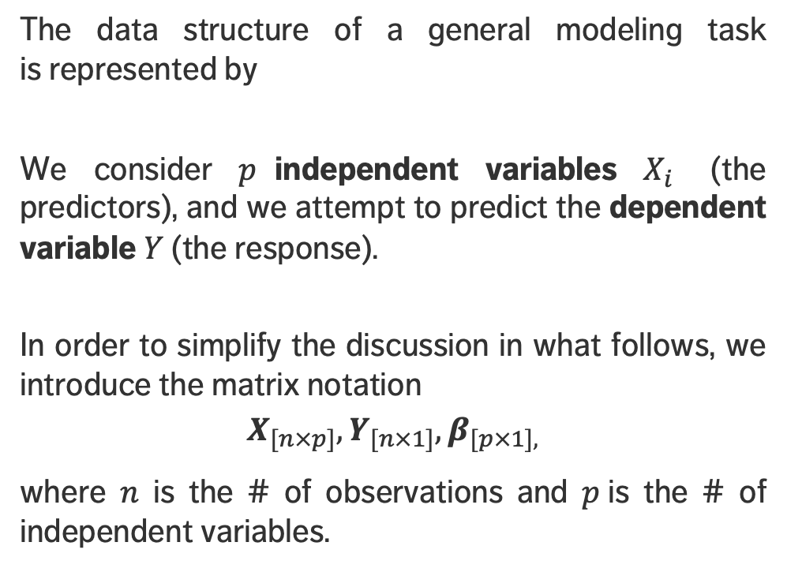
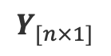
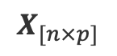
REGRESSION MODELING
The data structure of a general modeling task is represented by
We consider $p$independent variables $X_{i}$ (the predictors), and we attempt to predict the dependent variable $Y$ (the response).
In order to simplify the discussion in what follows, we introduce the matrix notation
$$X_{[n×p]},Y_{[n×1]},β_{[p×1],}$$
where $n$ is the # of observations and $p$is the # of independent variables.
$$X_{[n×p]}$$
$$Y_{[n×1]}$$

Slide 49
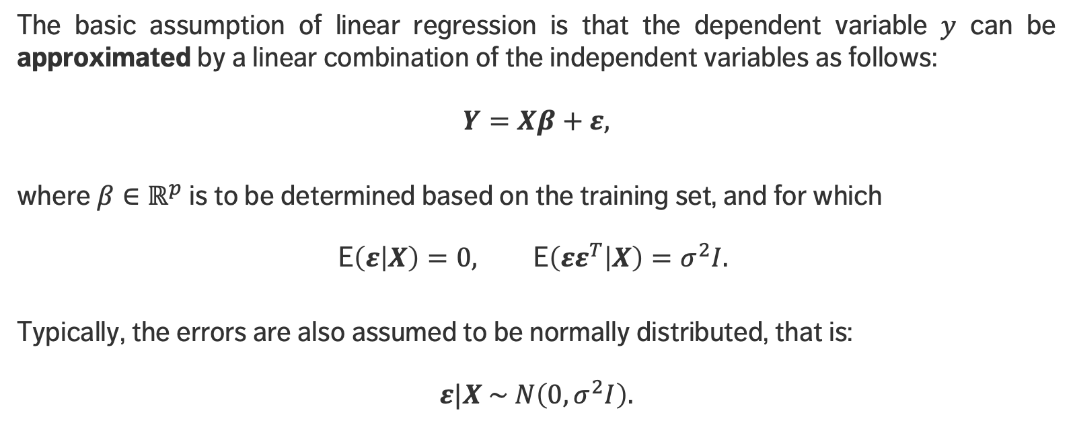
LINEAR REGRESSION
The basic assumption of linear regression is that the dependent variable $y$ can be approximated by a linear combination of the independent variables as follows:
$$Y=Xβ+ε,$$
where $β∈ℝ^{p}$ is to be determined based on the training set, and for which
$$\text{E}\left(ε | X\right)=0, \text{E}\left(εε^{T} | X\right)=σ^{2}I.$$
Typically, the errors are also assumed to be normally distributed, that is:
$$ε|X \sim N\left(0, σ^{2}I\right).$$

Slide 50
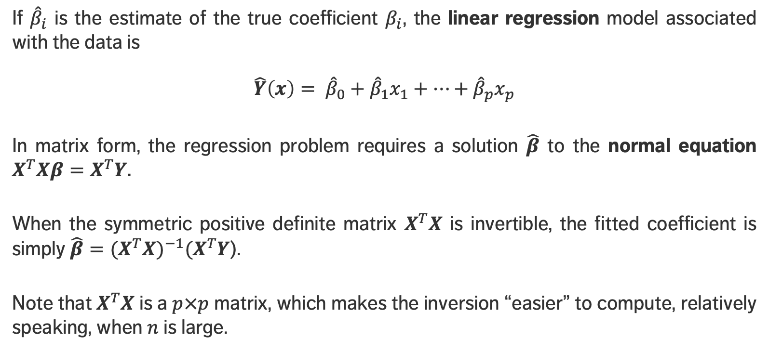
LINEAR REGRESSION
If ${\hat{β}}_{i}$ is the estimate of the true coefficient $β_{i}$, the linear regression model associated with the data is
$$\hat{Y}\left(x\right)= {\hat{β}}_{0}+{\hat{β}}_{1}x_{1}+⋯+{\hat{β}}_{p}x_{p}$$
In matrix form, the regression problem requires a solution $\hat{β}$ to the normal equation $X^{T}Xβ=X^{T}Y.$
When the symmetric positive definite matrix $X^{T}X$ is invertible, the fitted coefficient is simply ${{\hat{β}=(X}^{T}X)}^{−1}{(X}^{T}Y$).
Note that $X^{T}X$ is a $p×p$ matrix, which makes the inversion “easier” to compute, relatively speaking, when $n$ is large.

Slide 51
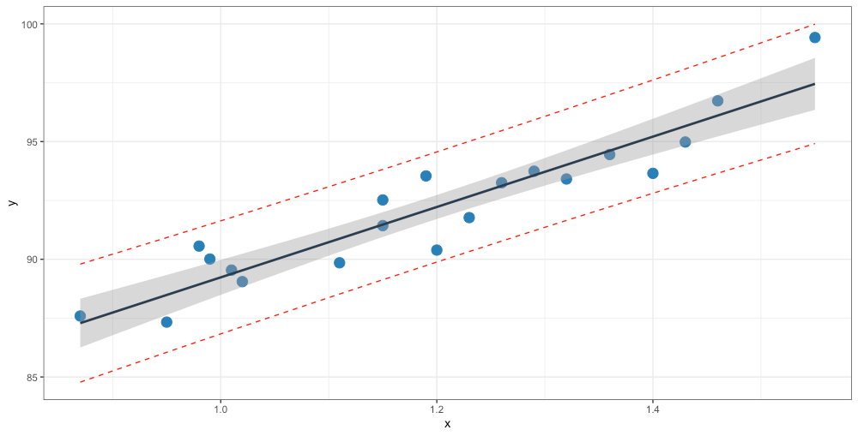
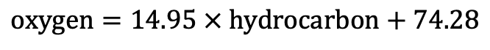
$$\text{oxygen}=14.95 × \text{hydrocarbon}+74.28$$
oxygen
prediction interval for new responses
confidence interval for mean response
hydrocarbon

Slide 52
TIME SERIES AND CONTROL CHARTS
BASIC DATA ANALYSIS

Slide 53
“NASA engineers did not identify the association between unexpectedly low launch-pad temperatures and O-ring failures in the space shuttle booster rockets.
They interpreted this critical signal as simply chance variation in the failure of the joints.
Lack of this insight was critical in the decision to launch the Challenger on its final and disastrous flight.”
Vaughan, D. [1997], The Challenger Launch Decision: Risky Technology, Culture and Deviance at NASA, p.383

Slide 54
STATISTICAL PROCESS MONITORING
Processes are often subject to variability:
variability due the cumulative effect of many small, essentially unavoidable causes (a process that only operates with such common causes is said to be in (statistical) control);
variability due to special causes, such as improperly adjusted machines, poorly trained operators, defective materials, etc. (the variability is typically much larger for special causes, and such processes are said to be out of (statistical) control).
The aim of statistical process monitoring (SPM) is to identify occurrence of special causes.

Slide 55
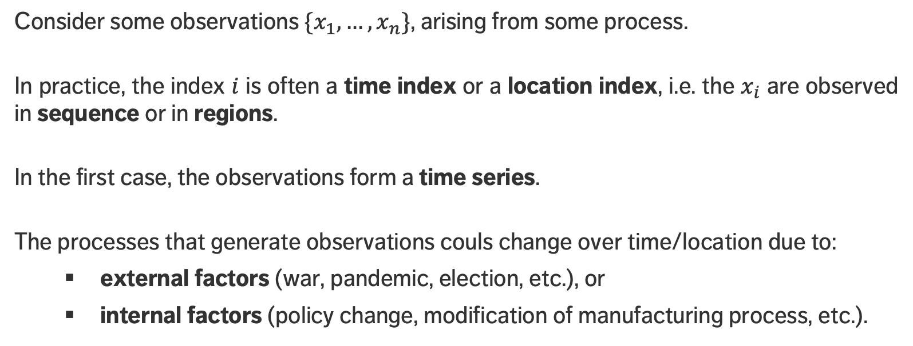
TIME SERIES
Consider some observations ${\{x}_{1},…,x_{n}\}$, arising from some process.
In practice, the index $i$ is often a time index or a location index, i.e. the $x_{i}$ are observed in sequence or in regions.
In the first case, the observations form a time series.
The processes that generate observations couls change over time/location due to:
external factors (war, pandemic, election, etc.), or
internal factors (policy change, modification of manufacturing process, etc.).

Slide 56
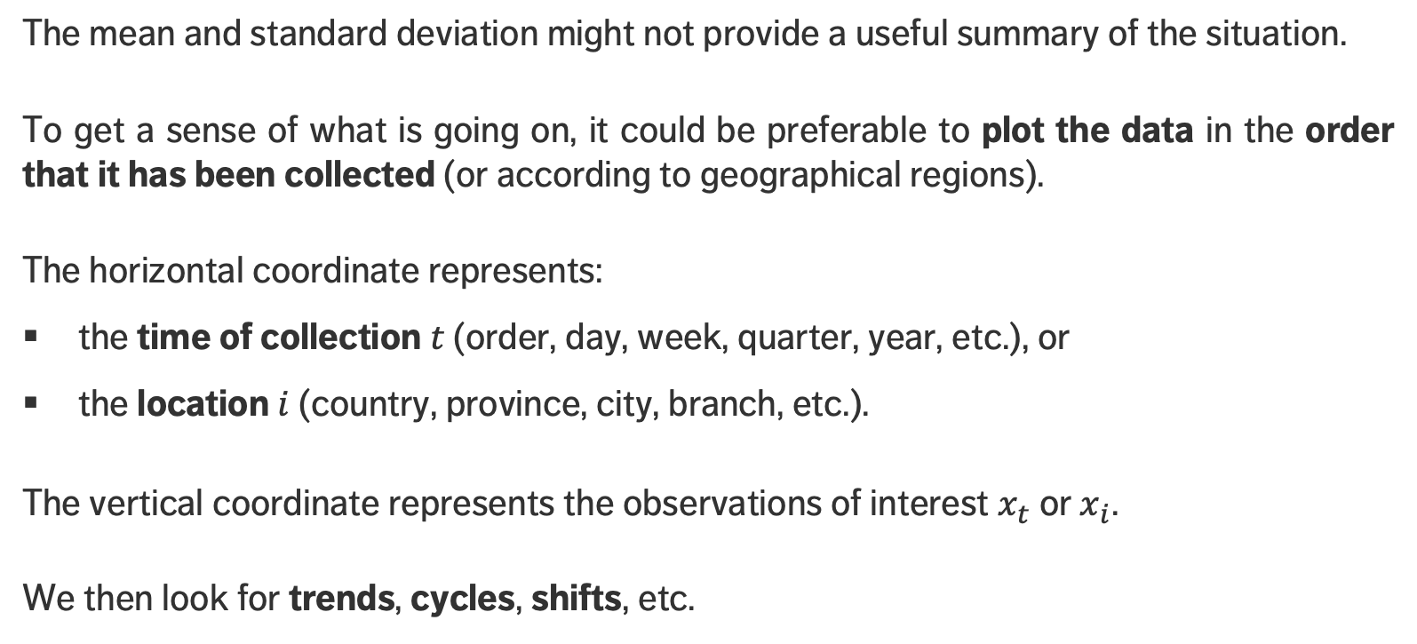
TIME SERIES
The mean and standard deviation might not provide a useful summary of the situation.
To get a sense of what is going on, it could be preferable to plot the data in the order that it has been collected (or according to geographical regions).
The horizontal coordinate represents:
the time of collection $t$ (order, day, week, quarter, year, etc.), or
the location $i$ (country, province, city, branch, etc.).
The vertical coordinate represents the observations of interest $x_{t}$ or $x_{i}$.
We then look for trends, cycles, shifts, etc.

Slide 57
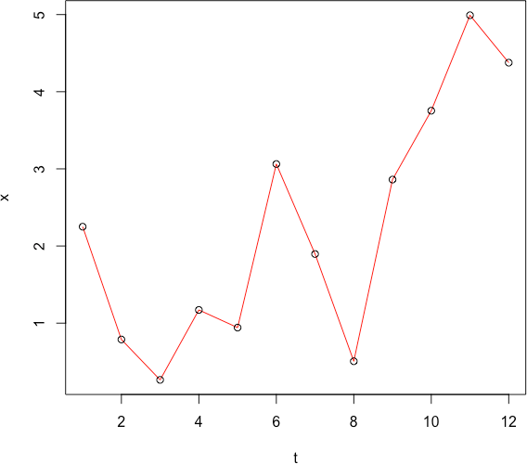
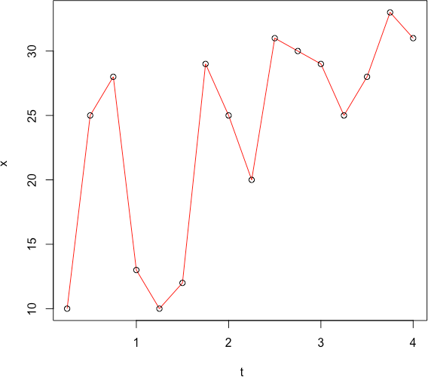
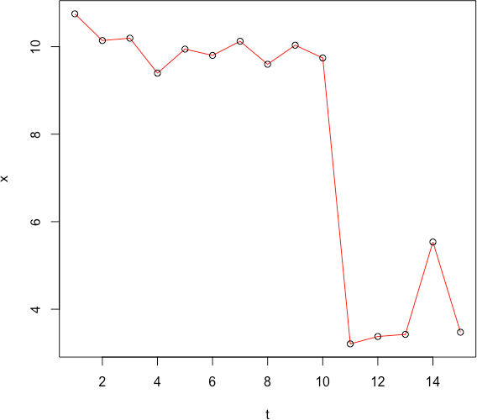
EXAMPLES
The following time series record sales $x$ (in 10,000$) for 3 different products, against the passage of time $t$ in years (left), quarters (middle), weeks (right). Is any action necessary?

Slide 58
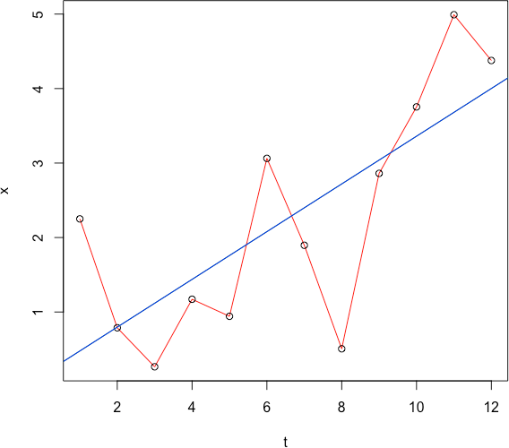
There are occasional drops in sales from one year to the next, but a clear upward trend.
If only the last two points are presented to stockholders, they might think that there are issues and that changes have to be made.

Slide 59
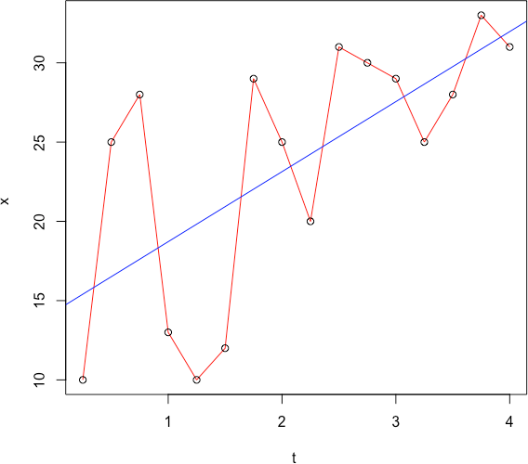
There is a cyclic effect with increases from Q1 to Q2, and from Q2 to Q3, but decreases from Q3 to Q4, and from Q4 to Q1.
Overall, there seems to be an upward trend, as indicated by the line of best fit.

Slide 60
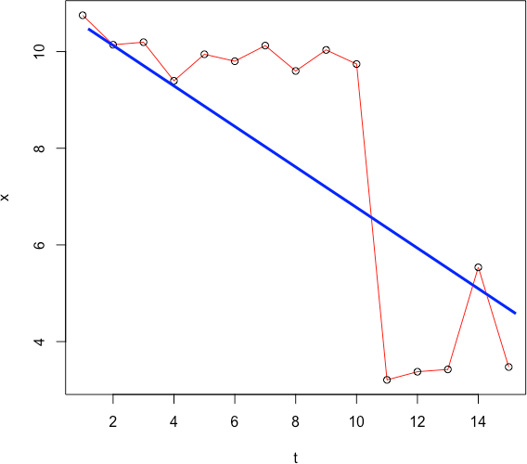
Clearly, something happened after the tenth week.
Whether the special causes are internal or external depend on the context (which we do not have at our disposal).
Action seems to be needed.

Slide 61
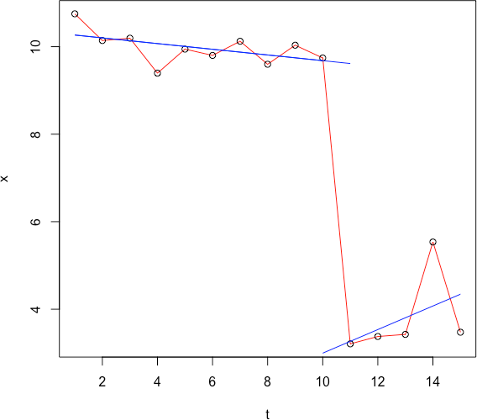
Clearly, something happened after the tenth week.
Whether the special causes are internal or external depend on the context (which we do not have at our disposal).
Action seems to be needed.

Slide 62
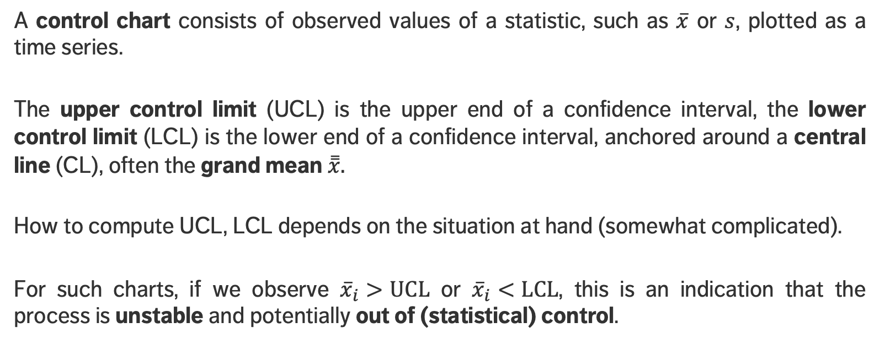
CONTROL CHARTS
A control chart consists of observed values of a statistic, such as $\overline{x}$ or $s$, plotted as a time series.
The upper control limit (UCL) is the upper end of a confidence interval, the lower control limit (LCL) is the lower end of a confidence interval, anchored around a central line (CL), often the grand mean $\overset{̿}{x}.$
How to compute UCL, LCL depends on the situation at hand (somewhat complicated).
For such charts, if we observe ${\overline{x}}_{i}>\text{UCL}$ or ${\overline{x}}_{i}<\text{L}\text{CL}$, this is an indication that the process is unstable and potentially out of (statistical) control.

Slide 63
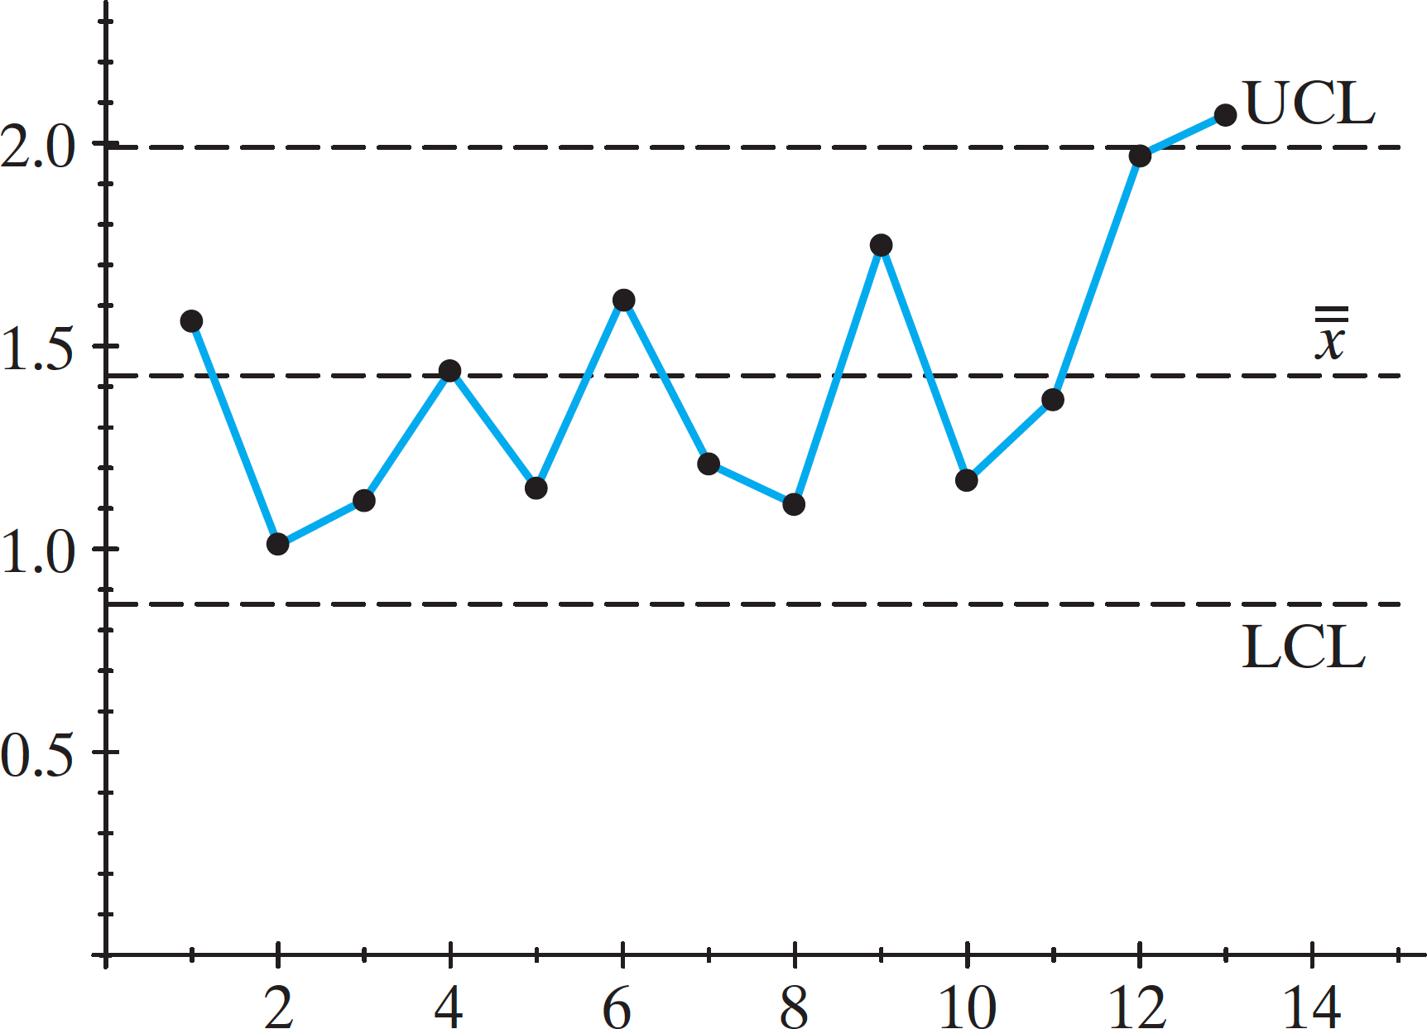
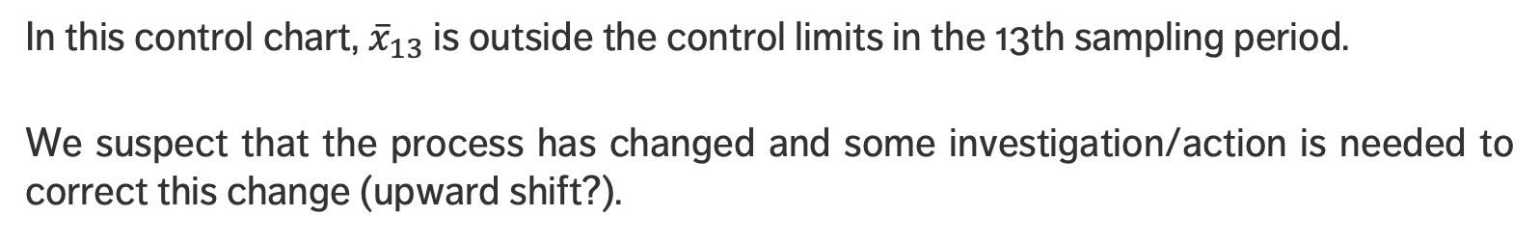
[Tannis and Hogg]
In this control chart, ${\overline{x}}_{13}$ is outside the control limits in the 13th sampling period.
We suspect that the process has changed and some investigation/action is needed to correct this change (upward shift?).

Slide 64
CONTROL CHARTS (REPRISE)
A control chart consists of:
points representing a sample statistic taken from the process at different times
the grand mean and the mean standard deviation of the sample statistic, which is computed using all observations, and is used to determine:
the center line, which is drawn at the value of the grand mean, and
the upper and lower control limits which indicate the threshold at which the process output is considered statistically unlikely (typically 3 standard deviations away from the central line).
optional features include:
upper and lower warning limits, drawn as separate lines, typically two standard deviations from the central line;
division into zones, with the addition of rules governing freq. of observations in each zone;
annotation for events of interest, from the point of view of process quality, and
action on special causes.

Slide 65



ILLUSTRATION
We are interested in the efficiency of $n=4$ counters in $N=5$ stations. The measurements are provided below.
Is there any reason to suspect that there are problems in any of the stations?

Slide 66

CONTROL CHART RULESETS
Several rule sets exist for flagging and detecting process instability and process control loss; they should be clearly stated prior to the start of SPM, and strictly adhered to.
Example:
a sample mean found outside the warning limits $⟹$ flag as a warning
a sample mean found outside the control limits $⟹$process out of control
a run of 7 successive sample means all above or all below the central line:
stop the production, quarantine and check
adjust process and check new successive samples
if all good, continue process; if not $⟹$return to step 1
a run of 7 successive sample means all showing improvement or all showing a decrease $⟹$follow previous sets of instructions

